Slide 1
City of Mineola Sales Tax Analysis
January 2021 – June 2022

Slide 2
Sales Tax January 2021-June 2022 Top 8 Industries
452210 DEPARTMENT STORES $1,112,467.50
722511 FULL SERVICE RESTURANTS $412,263.30
332311 PRE-FAB METAL BULD & COMP $392,983.49
444190 OTHER BUILDING MATERIAL DEL $217,460.82
447110 GASOLINE STATIONS $183,005.92
454110 ELECT. SHOPPING MALL/MAIL $153,654.16
722513 LIMITED SVC RESTURANTS $152,405.64
452319 ALL OTHER GEN MERCH STORES $139,349.46
January 2021 – June 2022
Total Receipts $4,315,860.15
Top 8 Industries $2,763,590.29
64% of Total Receipts

Slide 3
Sales Tax January 2021-June 2022 Trends
From May to June 2022
Department Stores up 6%
Full Service Restaurants up 5%
Pre-fab Metal Bldgs up 43%
Other Building Material up 13%
Convenience Stores w/Gas stations up 24%
From Jan 2021 to Jun 2022
Department Stores up 15%
Full Svc Restaurants up 22%
Pre-fab Metal Bldgs up 249%
Other Building Mat up 112%
Convenience Stores w/Gas Stations up 13%

Slide 4
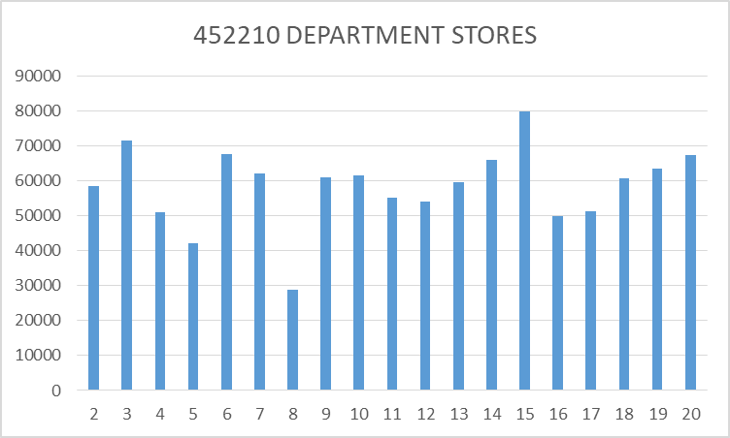
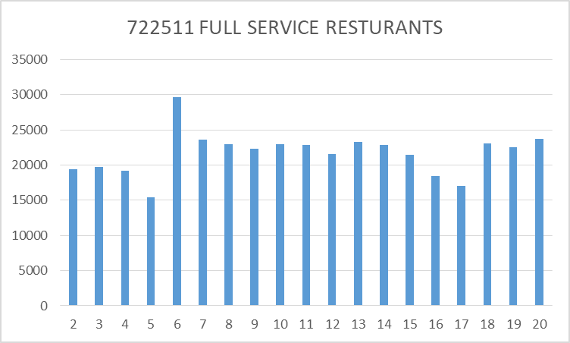
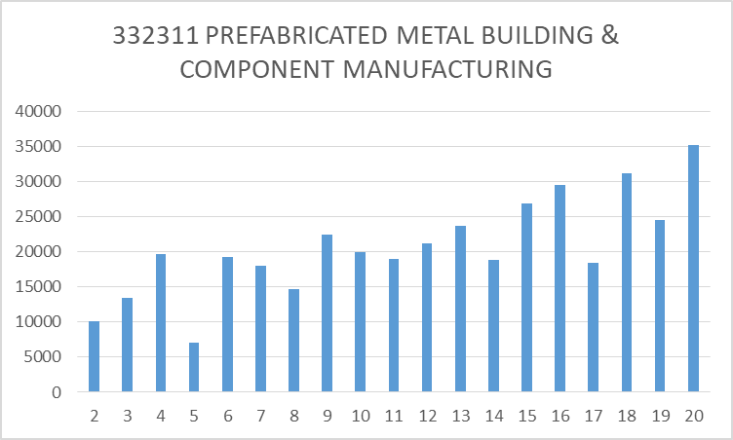
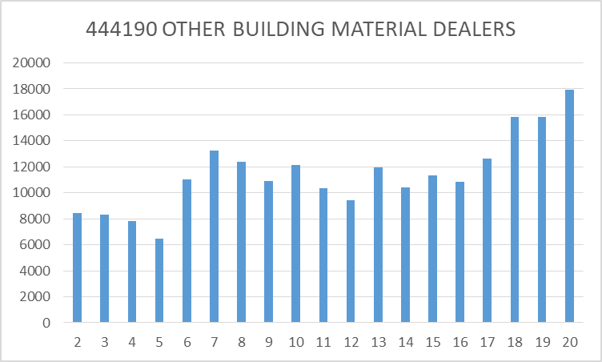
Sales Tax January 2021-June 2022

Slide 5
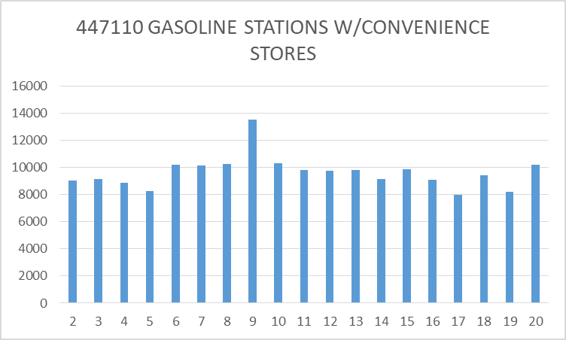
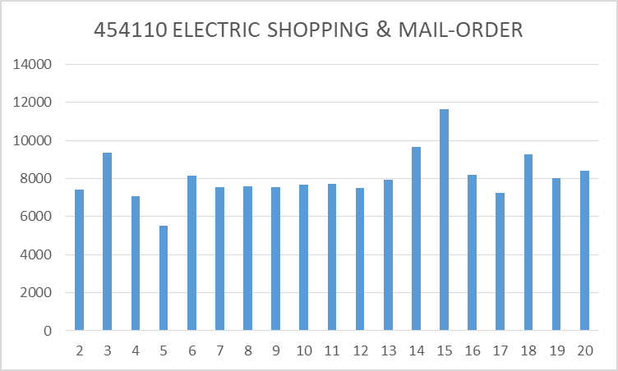
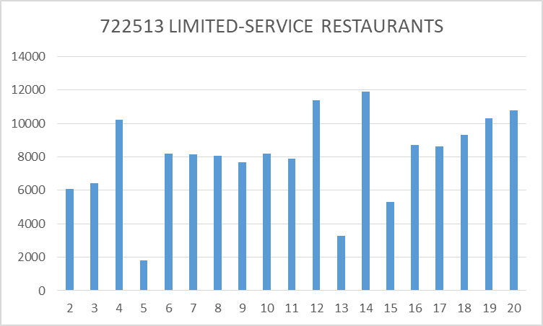
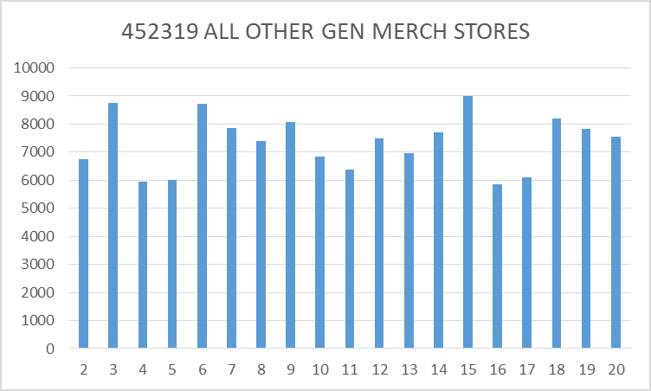
Sales Tax January 2021-June 2022

Slide 6
Sales Tax January 2021-June 2022 Other Industries w/Significant Growth
Limited-Service Restaurants up 77%
$6,077.04 to $10,780.97 (Total $152,405.64)
Nursery, Garden Center & Farm Supply up 73%
$4,526.72 to $7,825.90 (Total $120,663.24)
Cement Manufacturing up 53%
$3,223.24 to $4,932.56 (Total $74,767.93)
Other Prof Equip & Supplies Merchant Wholesalers up 144%
$1,031.87 to $2,516.86 (Total $60,363.98)

